Slide 1
CLUSTERING
DONE BY,
B.N.Faheen Fathima [15euit030]
S.Divya Bharathi [15euit028]
G.Dharani [15euit024]
Hindhu Sreeni [15euit040]

Slide 2
INTRODUCTION
UNSUPERVISED LEARNING
Clustering is the task of dividing the population or data points into a number of groups such that data points in the same groups are more similar to other data points in the same group than those in other groups.

Slide 3
WHY CLUSTERING?
• Organizing data into clusters shows internal
structure of the data
– Ex. Clusty and clustering genes above
• Sometimes the partitioning is the goal
– Ex. Market segmentation
• Prepare for other AI techniques
– Ex. Summarize news (cluster and then find centroid)
• Techniques for clustering is useful in knowledge
discovery in data
– Ex. Underlying rules, reoccurring patterns, topics, etc.

Slide 4
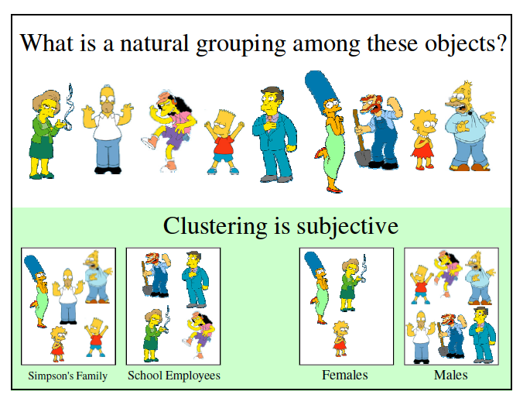

Slide 5
CLASSIFICATION OF CLUSTERING
Exclusive Clustering
Overlapping Clustering
Hierarchical Clustering
Probabilistic Clustering

Slide 6
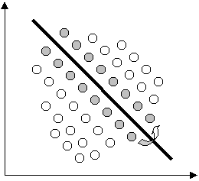
EXCLUSIVE CLUSTERING
If a certain datum belongs to a definite cluster then it could not be included in another cluster.
Example: K-means

Slide 7
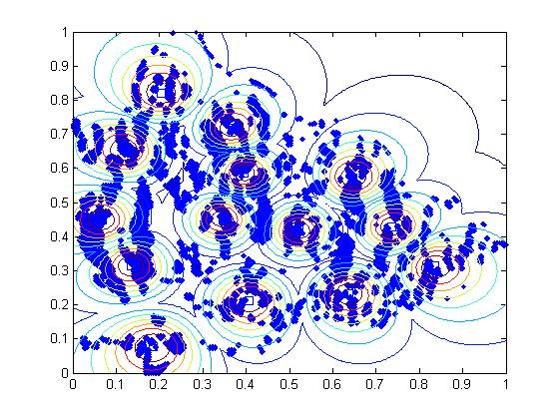
OVERLAPPING
If a certain datum belongs to a definite cluster but it can also be present in another cluster then it is called overlapping.
Example: Fuzzy C-means

Slide 8
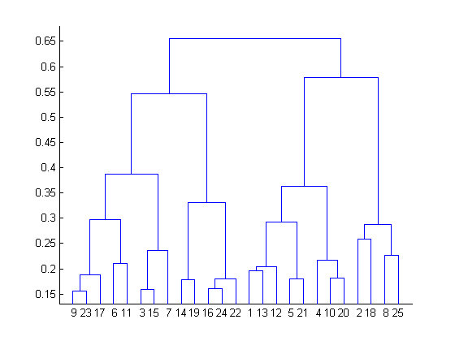
HIERARCHIAL CLUSTERING
A hierarchical clustering algorithm is based on the union between the two nearest clusters. The beginning condition is realized by setting every datum as a cluster(unsupervised). After a few iterations it reaches the final clusters wanted.
Example: Hierarchial clustering

Slide 9
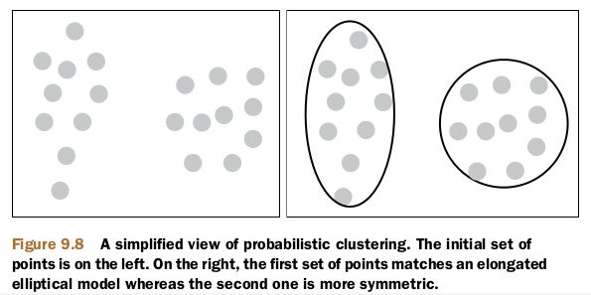
PROBABILISTIC CLUSTERING
The datum is classified using a completely probabilistic method. It includes calculating probability of the data and clustering it with close probability
Example : Mixture of Gaussian

Slide 10
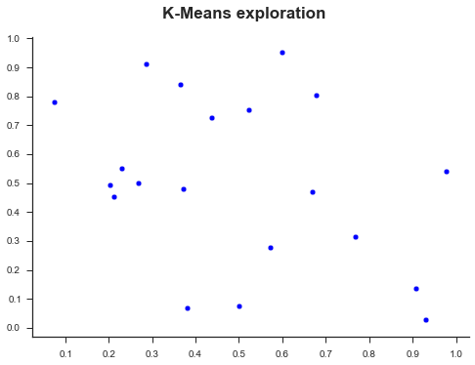
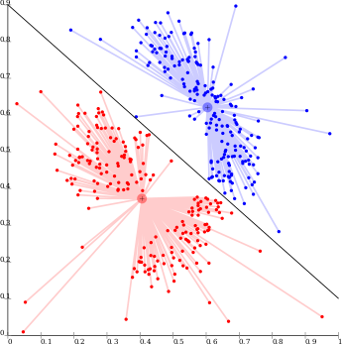
COMPARING K-MEANS AND FUZZY C MEANS

Slide 11
ADVANTAGES OF FUZZY C MEANS
A data point can be present in one or more clusters where in K means the data is strictly restricted
More accurate than K means
Probabilistic strategies can be applied to the clusters for more efficiency.

Slide 12
APPLICATIONS
Recommendation engines
Market segmentation
Social network analysis
Search result grouping
Medical imaging
Image segmentation
Anomaly detection
Pattern Recognition

Slide 13
THANK YOU!

